Slide 1
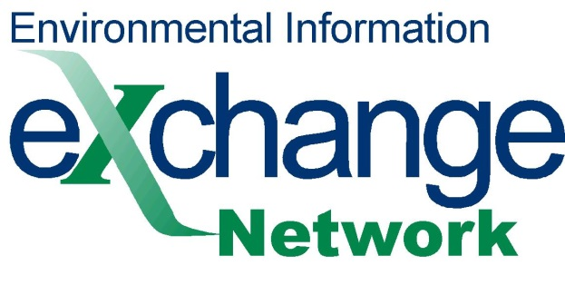
E-Enterprise/Exchange Network Open Call
Quick Guide to Using Virtual Exchange Services and the EN Service Center
September 21, 2016

Slide 2
VES and ENSC Descriptions
Exchange Network Service Center
The Exchange Network Services Center is a browser-based tool designed to allow Exchange Network users to easily send, retrieve, and download information from other partners (nodes) on the network. It supports manual file submission in any format XML, JSON, CSV, … which is great if you have already formatted the data for submission to CDX or a partner.
Virtual Exchange Services
The Virtual Exchange Service (VES) is a new cloud based platform for creating data exchanges on the Exchange Network. It eliminates the need for you to create and maintain a node server in your organization. It supports all of the functions of a node and simplifies the creation of data exchanges. It also supports a new communication model to simplify connectivity, the internet services bus (ISB). A web interface helps you configure your data flows. New data flows are created and data is published by simply filling out forms with no coding required. Data exchanges like AQS can be imported, which fills out the exchange forms for you and lets you concentrate on mapping your data to your staging tables.

Slide 3
Why VES
Provides a Low Cost Node Option for Partners
Eliminates Node Server Maintenance
Simplifies Development and Maintenance of Dataflows
You just need a database person for staging table management

Slide 4
VES Advantages
Virtual Exchange Services can supplement existing nodes (e.g. for a new dataflows)
Common Architecture: New features and dataflow definitions will be shared by all nodes
VES can inherit services
Services can be cataloged automatically

Slide 5


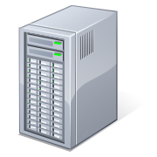
Partner
Environment
Cloud
Exchange Network/
CDX
REST or
SOAP
Admin
Virtual Node
Submissions
Configures Node
Staging Tables
Internet Service Bus
Or VPN
Reports
Staging data either
Local or the cloud
Notifications
Production Database
Staging Tables
VES

Slide 6
What you do What VES does for you
Division of Labor for VES
Call Node Help Desk
  Get a Node administrator account
  Set up a “Getting Started” meeting with VES Team
Establish a secure connection to VES
Import a Data Exchange
Map your data to a Staging Database
Creates SOAP and REST Services
Schedules data exchange
Authenticates
Pulls Data from staging
Formats data to XML
Sends submission to CDX
Logs activities
Checks Status
Collects processing reports
Sends Notifications to you

Slide 7
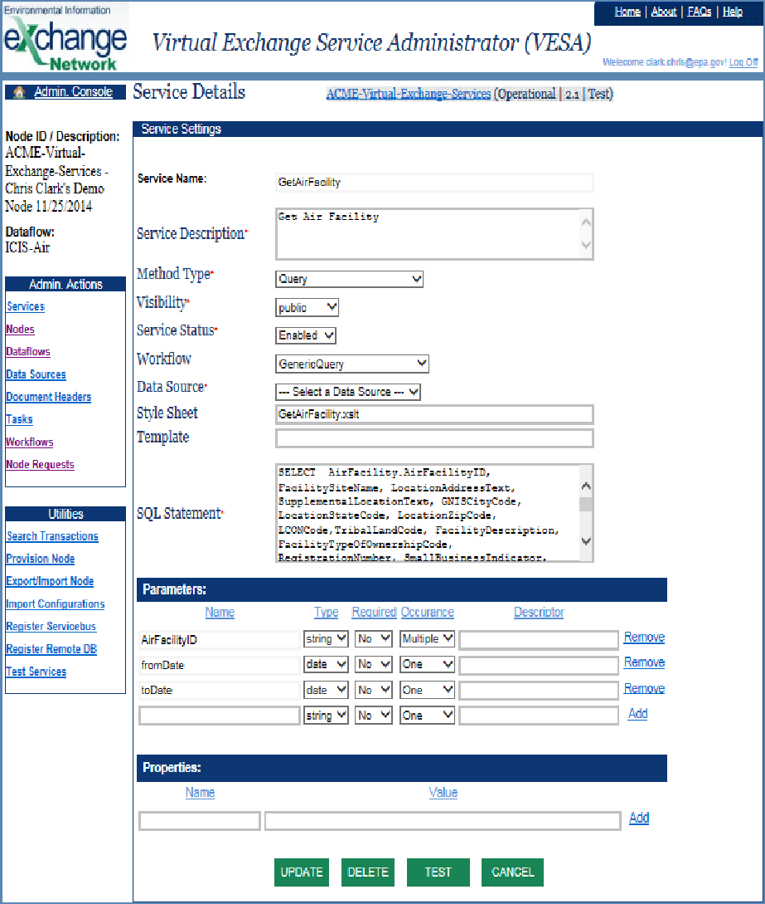

Configuring a Service in the VES Admin Tool
Test User | Profile | Logout
Home | About | FAQs | Help
Virtual Node Administration Platform (VNAP)
Node Dashboard
Services Setup Wizard
Steps
Service Settings
Database
Service
Template
Finish
Method Type
Explanation of Fields
Review these requirements to ensure your node is working.
Solicit
V
Workflow
Select a workflow…
Node ID / Description: CWANJ - Clean Water Act NJ Waterways
Dataflow: CWANJ
V
Service Status
Enabled
V
Service Description
Display all water transaction data
Data Source
Please select an existing data source and provide SQL statement to test
cgi.oracle.test
V
SQL Statement
SELECT * FROM {TABLE} WHERE {FIELD}.{TABLE}
TEST QUERY

Slide 8
REST Services
Virtual Exchange Services can create REST type services for publishing data
GetCountyCode – actual REST service on my Chris Clark Production VES:
This is what the REST service URLs look like for my VES REST services
JSON format:
https://virtualnode.cloudapp.net/nodedataservice?node=ChrisClarkProductionNode&Dataflow=RESTServices&request=GetCustomerList&CustomerId=B&format=json
XML format:
https://virtualnode.cloudapp.net/nodedataservice?node=ChrisClarkProductionNode&Dataflow=RESTServices&request=GetCustomerList&CustomerId=B&format=XML

Slide 9
Partners
Hualapai Tribe: WQX production flow
San Joaquin Valley Air District: ICIS AIR
Jefferson County Health Dept – ICIS Air
Klamath Tribe - WQX
Alabama: ICIS-AIR
Georgia: Building ICIS AIR dataflows for data families , EIS
Region 1 Storm 3 Buoy Flow, SPCC Tanks
South Dakota: TRI-OUT , ICIS-AIR, EIS
Tennessee – ICIS-AIR, ICIS NPDES
Texas – AQS, Facility FRS
Maine: ICIS Export
Gold Systems: WQX, ICIS AIR, AQWMS

Slide 10
Data Exchanges Supported
AQS 3.0
ICIS-AIR
FACID v3.0 (FRS)
eBeaches
EIS
EMTS v3.0
ENDS v2.0
ICIS-NPDES
SPCC v1.1 (Region 1)
Buoy Data (Region 1)
TRI (OUT)
UIC
WQX v2.0
CROMERR
OWIR_ATT
RCRA

Slide 11
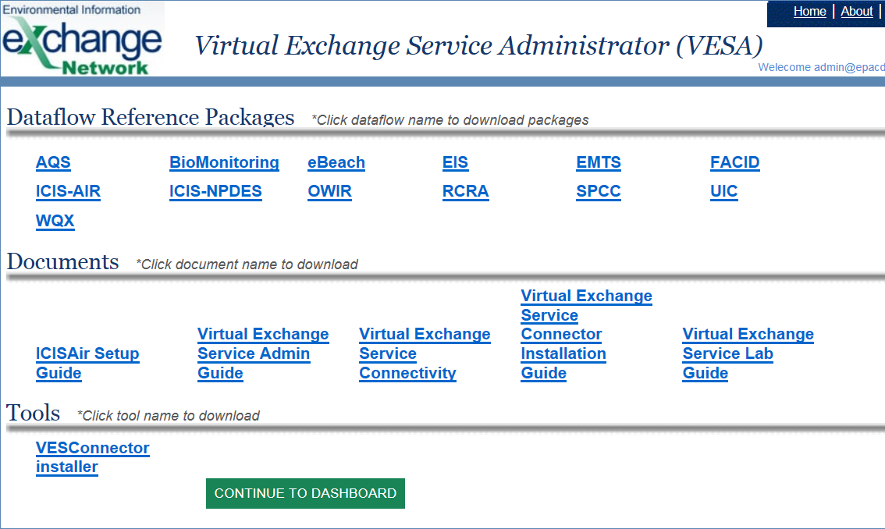

Slide 12
VES/ENSC “Decision Tree”

Slide 13
VES/ENSC “Decision Tree” (cont.)

Slide 14
VES/ENSC “Decision Tree” (cont.)

Slide 15
VES/ENSC “Decision Tree” (cont.)

Slide 16
General FAQs

Slide 17
General FAQ Topics
General Exchange Network
E-Enterprise for the Environment
Virtual Exchange Service
Exchange Network Service Center
Minimum Requirements

Slide 18
FAQ: What is the Exchange Network?
The Exchange Network is a partnership among States, Territories, Tribes, and the U.S. Environmental Protection Agency that is improving and expanding the exchange of environmental information.
First envisioned in 1998, the Exchange Network is an established communication, data, and services platform for sharing environmental information to foster informed decision-making. This network is managed under the collaborative leadership of EPA, States, Territories, and Tribes.
Using the Exchange Network, States, Territories, Tribes, universities, not-for-profit organizations, and others can share data with EPA and other Network Partners securely via the Internet.
More information is available at: http://www.exchangenetwork.net/about/ and at the searchable Exchange Network Knowledge Base: http://www.exchangenetwork.net/knowledge-base/.

Slide 19
FAQ: What is E-Enterprise for the Environment?
E-Enterprise for the Environment (E-Enterprise) is a transformative 21st-century strategy to modernize how government agencies deliver environmental protection. Through joint governance, States, Territories, Tribes, and EPA are collaboratively streamlining business processes while driving and sharing innovations across agencies and programs.
More information is available at: https://www.epa.gov/e-enterprise.

Slide 20
FAQ: What is Virtual Exchange Service?
Formerly known as the Virtual Node, the Virtual Exchange Service (VES) is a cloud-based platform for creating data exchanges on the Exchange Network. The VES eliminates the need for Partners to create and maintain a node server. The VES supports all of the functions of a node and simplifies the creation of data exchanges. It also supports a new communication model to simplify connectivity, (i.e., the Internet services bus).
The Virtual Exchange Service Administrator is a web interface used to configure data flows. New data flows are created and data is published by filling out forms, with no coding required. Data exchanges can be imported from a shared version that fills out the forms, allowing Partners to concentrate on mapping data to their staging tables.
The Virtual Exchange Service evolved from the guidance and recommendations. This feedback is based on input from the Exchange Network Virtual Node Integrated Project Team (IPT) that was formed to discuss and investigate the adoption of a virtual node platform on the Exchange Network.
More information is available at: http://www.exchangenetwork.net/virtual-exchange-service/.

Slide 21
FAQ: What is the Exchange Network Service Center?
The Exchange Network Services Center (ENSC) is a browser-based tool designed to allow Exchange Network users to easily send, retrieve, and download information from other partners on the network. It supports manual file submission in any format, including common formats such as XML, JSON, and CSV.
The ENSC is available at: https://enservices.epa.gov/.

Slide 22
FAQ: What are the minimum requirements?(1 of 2)
  Virtual Exchange Service
Component | Minimum Requirement
Machine | Windows 64-bit Internet connected computer with modern web browser
Browser | Modern web browser
Database | Staging database is required; options include: SQL Server Express Edition SQL Server Oracle
Additional Connectivity | Either Virtual Private Network (VPN), which requires firewall rule changes, or Internet Service Bus (ISB), which requires no changes to the firewall
Additional Tools | Tool or process to map data into staging database
Technical Skill Level | Database processing to move data from source(s) into staging database

Slide 23
FAQ: What are the minimum requirements?(2 of 2)
  Exchange Network Service Center
Component | Minimum Requirement
Machine | Internet-connected computer with modern web browser
Browser | Modern web browser
Database | N/A
Additional Connectivity | N/A
Additional Tools | Tool or process to create submission documents based on the target format for trading for the data exchange
Technical Skill Level | Development of processes to transform source data into target exchange format (often XML)

Slide 24
VES Frequently Asked Questions

Slide 25
VES FAQ Topics
What are the ‘services’ provided by the Virtual Exchange Service?
What data exchanges are currently available in the Virtual Exchange Service?
What is the Virtual Exchange Service Administrator?
What kind of security is available/required for the Virtual Exchange Service?
What are the components or objects that the Virtual Exchange Service provides virtually?
How do I administer my data flows when using Virtual Exchange Service?
Can Virtual Exchange Service be used to for a custom flow (an exchange not currently available in the Virtual Exchange Service)?
What are the additional connectivity requirements for the Virtual Exchange Service?
Is the Virtual Exchange Service an option for an Exchange Network member with limited Internet connectivity?
What are the operations and maintenance impacts of adopting the Virtual Exchange Service?
Is the Virtual Exchange Service less secure than a traditional node because it is a cloud solution?
Can the Exchange Network Help Desk assist an Exchange Network Partner with getting started with the Virtual Exchange Service?
What additional Virtual Exchange Service resources are available?

Slide 26
  What are the ‘services’ provided by the Virtual Exchange Service?
The Virtual Exchange Service (VES) uses a ‘services’ approach to accomplish all of the functions associated with the exchange of data over the Exchange Network.
For example, the VES has a complete set of prebuilt services to support ICIS-AIR. For ICIS-AIR alone, there are 22 services that can be used; services include:
  GetAirFacilityQuery – Reads data from the staging tables in the database and creates an Extensible Markup Language (XML) file.
  SubmitAirFacilityDataExecute – Submits the XML file and receives the associated response information.

Slide 27
  What data exchanges are currently available in the Virtual Exchange Service?
The currently available data exchanges can be located on the home page of the Virtual Exchange Service Administrator (VESA).
The VESA is available at: https://vnap.cloudapp.net.

Slide 28
  What is the Virtual Exchange Service Administrator?
The Virtual Exchange Service Administrator (VESA) is the web interface that is used to configure data flows. New data flows are created and data is published by filling out forms, with no coding required. Data exchanges can be imported from a shared version that fills out the forms, allowing Partners to concentrate on mapping data to their staging tables.
The VESA is available at: https://vnap.cloudapp.net.

Slide 29
  What kind of security is available/required for the Virtual Exchange Service?
Virtual Exchange Service (VES) is fully integrated with network as a service (NAAS) for user authentication and authorization. When a virtual exchange service (node) is created, it is assigned to an owner; the service owner has full control over who can access each service using NAAS security policies.
Although hosted in the same environment with other nodes, the virtual exchange service management interface operates in its own sandbox, and allows only the service owner to make changes to the VES properties and configurations. For instance, VES A’s administrator will not be able to create a service for VES B.
A virtual exchange service has the same access control mechanisms as any Network node. The node administrator’s authorization is required for accessing node services.

Slide 30
  What are the components or objects that the Virtual Exchange Service provides virtually?
A Virtual Exchange Service (VES) has five key objects that its owner can create and manage. They are:
  Node: Contains the definition of a virtual exchange service including its address (endpoint), description, owner, and other properties.
  Data Source: Defines an access point where information is supplied. In most of situations, a data source contains database server name, address, login account, and other connection information.
  Data Flow: A logical collection of services that deal with a common set of information exchanged between partners (ex. RCRA). A VES owner can create a data flow and set its properties.
  Service: A definition of what must be provided. A VES owner adds new features to a network node by creating services. The services are the basic operation unit that a node executes at runtime.
  Task: A set of operations to be executed automatically on a scheduled basis. For instance, a task can be created to perform quarterly submissions to a CDX data flow.

Slide 31
  How do I administer my data flows when using Virtual Exchange Service?
The Virtual Exchange Service Administrator (VESA) provides a web interface to allow provisioning and maintenance and data flows. In addition to the web interface, a Simple Object Access Protocol (SOAP) application program interface (API) is available. The API that allows administrative functions to be scripted or integrated into other applications.
The Virtual Exchange Service Administrator’s Guide is available at: http://www.exchangenetwork.net/virtual-exchange-service/.

Slide 32
  Can Virtual Exchange Service be used to for a custom flow (an exchange not currently available in the Virtual Exchange Service)?
Yes – the Virtual Exchange Service (VES) can be used to publish information to the Internet and to exchange data with partners. For example, to publish database information as web services, create an SQL statement and VES will construct an Extensible Markup Language (XML) document accordingly. Users may convert the XML into any other format using a style sheet. VES offers many examples as templates that can be customized to meet specific requirements.
The flow is configured manually through the completion of forms instead of shared templates. VES offers a set of common workflows and handles transaction-related tasks as part of its core capabilities.
Partners who utilize custom flows can test or submit data flows directly from Virtual Exchange Service Administrator (VESA). If the action is a query, partners can access it either from the Exchange Network Services Center (ENSC) or from an Internet browser using the flows-associated representational state transfer (REST) Uniform Resource Locator (URL). The owner of the VES node must authorize Partners through network as a service (NAAS) policies. The Node Help Desk can be contacted at nodehelpdesk@epacdx.net for support on NAAS security policies and services.
REST services are created for all publishing services (queries) in addition to the Simple Object Access Protocol (SOAP) service. These can be made accessible from any browser with or without authentication.

Slide 33
  What are the additional connectivity requirements for the Virtual Exchange Service?
Before creating a data source, there must be network connectivity from the Virtual Exchange Service (VES) to the database server. Connectivity options are:
  Internet Service Bus: A network agent (or adapter) called the Virtual Exchange Service Connector is provided to relay network traffic between the network node and an authenticated local database server. This is the preferred option as the Virtual Exchange Service Connector provides secure network connectivity without changing firewall rules.
  VPN: A virtual private network (VPN) can be setup from the VES to a local database server. The connection is secured with key-based authentication, and all traffic is encrypted. For point-to-point tunneling, the database-side firewall rule must be adjusted to allow connections from the VES. Please coordinate with node helpdesk for VPN connections.
  Azure Connect: Similar to VPN, Azure Connect is a cloud connectivity agent that can be installed on the database server to establish a point-to-point secure virtual network. Azure Connect is based on Internet Protocol Security (IPSEC); all traffic between VES and the database server is encrypted.
It is the responsibility of a VES owner to establish network connectivity. The VES engineer and Exchange Network helpdesk, at nodehelpdesk@epacdx.net, will provide assistance as needed.
The Virtual Exchange Service Administrator’s Guide is available at: http://www.exchangenetwork.net/virtual-exchange-service/.

Slide 34
  Is the Virtual Exchange Service an option for an Exchange Network member with limited Internet connectivity?
Yes – connectivity does not have to be always on. However, connectivity should be on whenever possible if the Virtual Exchange Service (VES) is used for data publishing so that a Partner can access the service at any time. The VES is resilient to network disruptions because many retry mechanisms have been built into its business process.

Slide 35
  What are the operations and maintenance impacts of adopting the Virtual Exchange Service?
The traditional operation and maintenance (O&M) burdens for server and node maintenance are eliminated under the Virtual Exchange Service (VES). The O&M for Network Nodes is performed under VES.
Data flow maintenance may still exist. If a new data flow version is released, some maintenance steps may be required. Under VES, the maintenance required for similar data flow changes under traditional interface and node architectures can be reduced. Maintenance may include steps such as:
  Create new staging tables (using scripts for the data flows with existing templates)
  Remap source data to a new staging table structure
  Import and update the latest template from VES

Slide 36
  Is the Virtual Exchange Service less secure than a traditional node because it is a cloud solution?
No - the controls available are the same as those available with a local node. The node owner has complete control over access to the data in the Virtual Exchange Service (VES) Node. VES communicates with the staging database as if it were local, extracts data, formats the data, and submits data. The owner of the VES node has complete control and custody of the node.

Slide 37
  Can the Exchange Network Help Desk assist an Exchange Network Partner with getting started with the Virtual Exchange Service?
The Exchange Network Help Desk (nodehelpdesk@epacdx.net) can walk a Partner through the establishment of a Virtual Exchange Service (VES) administration account that is authorized to manage VES with the Virtual Exchange Service Administrator (VESA). The Help Desk can also help organize a meeting with VES engineers to help assess a Partner’s needs. Additionally, introductory VES guidance can be provided.

Slide 38
  What additional Virtual Exchange Service resources are available?
Extensive documentation is available at: http://www.exchangenetwork.net/virtual-exchange-service/. Resources include:
  Lab Guide v1.0
  Guidance and Recommendations Document v1.0
  Developer’s Guide v1.0
  Connector Installation Guide
  Administrator’s Guide v4.0
  Internet Service Bus and Classic VPN Comparison v1.0
  ICISAir Setup Guide
  VES Demonstration – January 21, 2015, EN Open Call
  EN2015 VES Presentation
In addition, the initial startup phases of a Virtual Exchange Service (VES) effort typically include collaborative meetings with interested Exchange Network Partners and VES engineers. VES engineers explain documentation and provide continuous custom support to ensure that Exchange Network Partners are successful in their VES implementations.

Slide 39
ENSC FAQs

Slide 40
ENSC Topics
What methods does the Exchange Network Service Center utilize for the exchange of information?
Does the Exchange Network Service Center provide multiple options for using data services?
How can a Partner request access to the Exchange Network Service Center?

Slide 41
  What methods does the Exchange Network Service Center utilize for the exchange of information?
The Exchange Network Services Center utilizes three methods for the exchange of environmental information:
  Send Info: Submit documents or information to another system on the Exchange Network.
  Get Info: Retrieve information from another system on the Exchange Network. This information is either retrieved immediately through query services or requested and then downloaded through solicit services.
  Download: Download a document from another system on the Exchange Network with a transaction or document ID.

Slide 42
  Does the Exchange Network Service Center provide multiple options for using data services?
Yes - the Services Center provides two options for using data services.
  Guide Me Step-by-Step guides more novice users through the steps necessary to complete the transaction.
  Express Request allows advanced users to quickly complete their transaction.
The Service Center tracks a user’s previously utilized services and past activity to ease future access.

Slide 43
  How can a Partner request access to the Exchange Network Service Center?
The Exchange Network Help Desk (nodehelpdesk@epacdx.net) can walk a Partner through the establishment of an account that is authorized to access the Exchange Network Center (ENSC).

